Slide 1
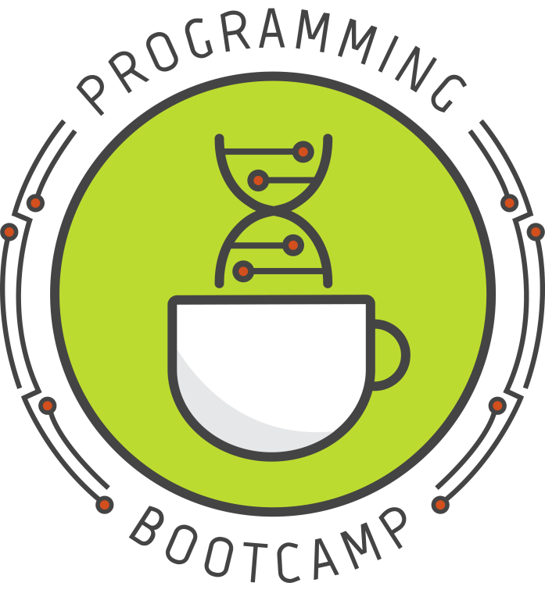


Welcome to Programming Bootcamp!
(Please sign-in in the back)
Sponsored by:
Notes:
Thanks so much to BGS,IBI, and GCB for sponsoring this year's bootcamp! Thank you to Sarah Middleton for creating and making this workshop possible. This workshop is is run by students who are juggling research and volunteering so I apologize in advanced and thank everyone for their patience. There will be two lecturers: Apexa and Scott and handful of TA that will be providing help through out the course.
http://upibi.org/

Slide 2
Goal
Get you comfortable enough with Python basics that you can easily learn more on your own when the course is done.

Slide 3
Advice for getting the most out of this course
Do the problem sets!!
Review the answers when they are released
Always try to solve problems yourself first
BUT: don't be afraid to ask questions when you get stuck!

Slide 4
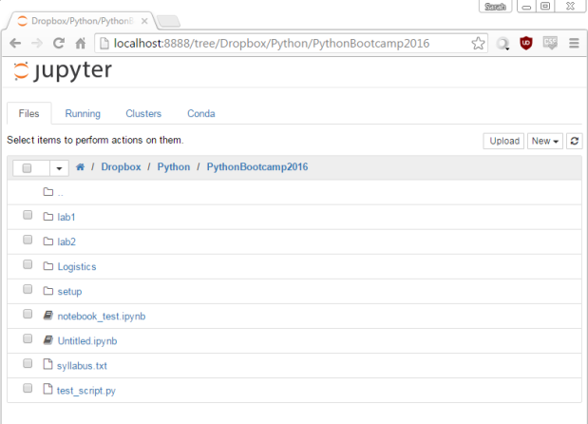
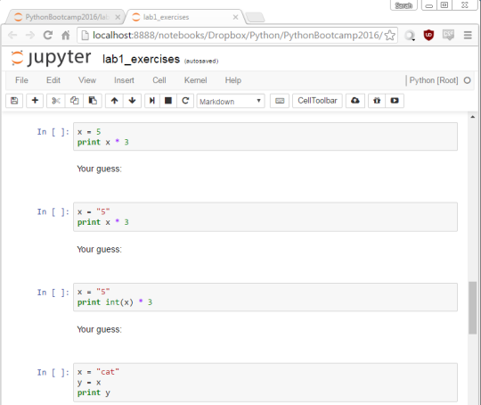
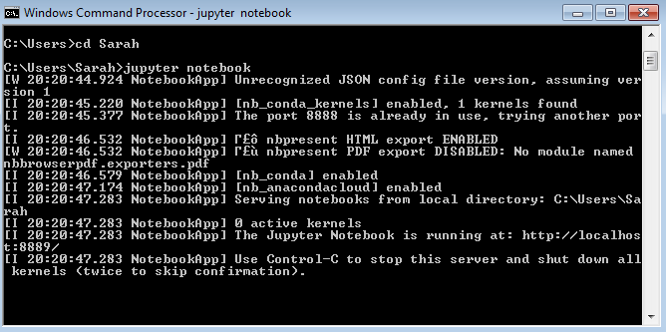
Launches
Opens
Jupyter Server
Do not close this window until you are completely done!
You can't use this terminal window while the server is running
To end the server: Ctrl+C twice
This server is not accessible from the internet (there are ways you could make it accessible, but it's not by default).
Jupyter File Browser
Do not close this tab until you are completely done!
The files shown are all on your computer.
Although it uses your web browser, it does not use the internet.
Think of it as just a viewer/naviagtor for files on your computer.
Click a notebook (.ipynb file) to open it.
Jupyter Notebook
You can have many notebooks open at once.
Closing this tab does not actually terminate the notebook (it'll keep running in the background).
To terminate the notebook, go to File > Close and Halt
When you edit this notebook here, you are editing the notebook on your computer.
When you save this notebook here, you are saving it on your computer.
Make sure to save before closing.

Slide 5
Conventions used in these slides
Text written in fixed width font represents actual Python code or terminal commands.
Color Codes:
code comments will be green
reserved words and built-in functions will be blue
Notes:
NOTE: If you try to copy and paste code from this powerpoint, be aware that any code containing curly quotes ("" '') will cause errors. You need to change them to regular straight quotes first (just retype them in your text editor or notebook and they will be corrected).
"comments" "reserved words" and "built-in functions" will be explained later
Reserved words are words that cannot be used as identifiers

Slide 6
Introduction to Programming and Python
Programming Bootcamp 2019
Session 1 – 6/25/2019
Lecturer: Apexa Modi

Slide 7
Today's topics
What is a program?
Writing and running Python code
Print statements
Error messages
Variables & data types
Basic math
Note: If you're following along online, see the notes panel (below the slides) for some additional clarifying information.
Notes:
Hello, this is the notes panel ☺

Slide 8
1. What is a program?

Slide 9
What is a program?
Program - A set of instructions that tells the computer how to perform a task.
The words "program" and "script" can often be used interchangeably, though "script" is generally used to describe quicker, simpler programs.
Notes:
You can think of a program a bit like a recipe: it gives step-by-step instructions on how to combine data and functions (ingredients) to achieve the desired end result (a tasty cake)
The program must be written in a language the computer can understand. This is where languages such as Python come in.

Slide 10
What is a programming language?
Computers only understand binary (0's and 1's)
Writing code in binary is very hard for humans.
So, programming languages were created:
Human writes code in human-friendly language
An "interpreter" or "compiler" translates the code into computer language
The computer runs the translated code
Python is just one of many such "human-friendly" programming languages.

Slide 11
Why learn Python?
It's a particularly simple and easy to learn language
It's widely used by scientists
Personal preference

Slide 12
2. Writing and running Python code

Slide 13
Two main ways to use Python
Using Jupyter Notebooks:
write code in "cells" and then execute individual cells, one at a time
run in the web browser; requires notebook viewer
Using scripts:
write code in a file and then execute the whole file at once
run from the terminal
Notes:
Note that there are actually a few other ways to use Python, e.g. in the interpreter. But in this class, we'll only use notebooks and scripts

Slide 14
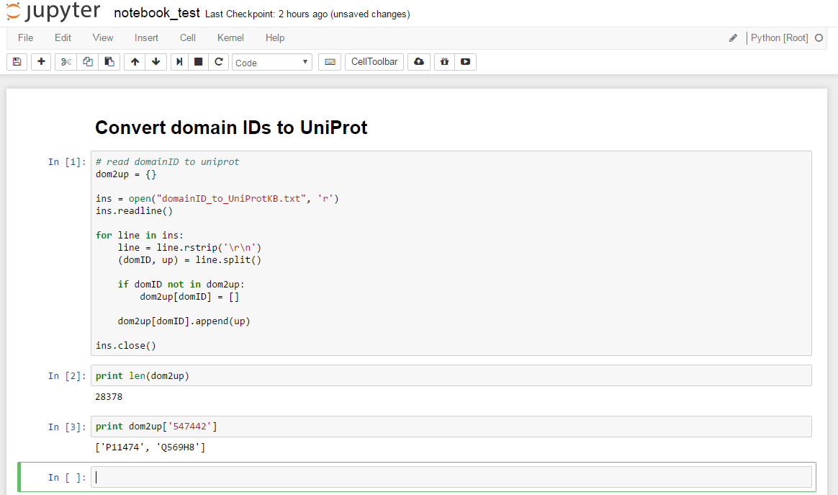
Jupyter Notebooks
"cells"
(text or code)
code output
Notes:
The notebook basically consists of a series of cells. Each cell can contain one or more lines of code. When you select a cell and hit Shift+Enter or Ctrl+Enter, the code in the cell is executed.

Slide 15
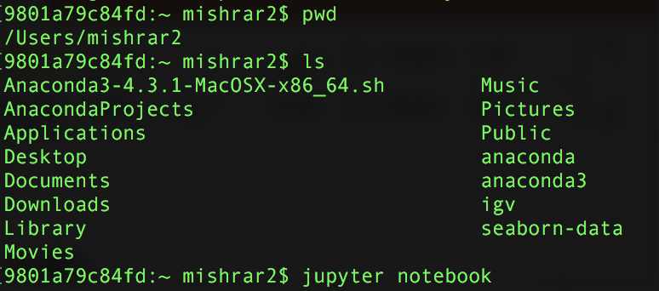
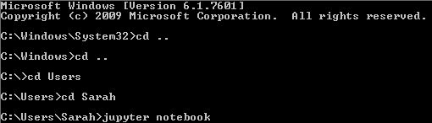
Using Jupyter Notebooks (do this now)
Open a terminal window
(Optional) Navigate to a convenient directory
the directory where you launch Jupyter becomes the root for that session, and you will only be able to access directories within that root directory.
use cd <directoryName> and cd .. to move around
Launch the notebook with the following command:
jupyter notebook
Example (on Windows)
Example (on Mac)
Notes:
See quick_ref_jupyter.pdf (posted on Piazza) for a quick reference

Slide 16
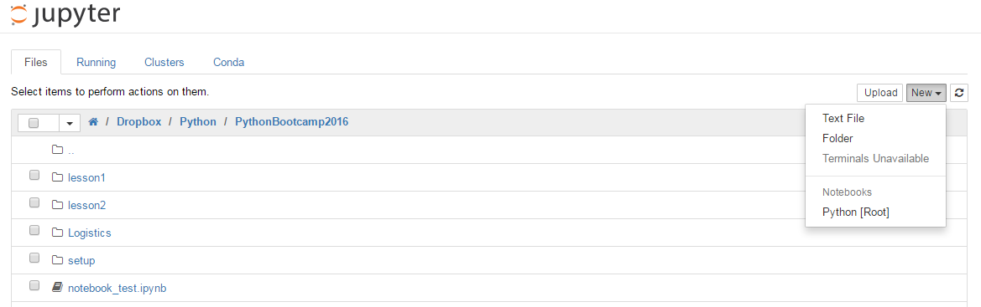
Using Jupyter Notebooks (do this now)
A web browser window should pop up. This is the Jupyter file browser.
Navigate to the folder where you would like the new Jupyter notebook to be.
Click 'New' in the upper right corner and select 'Python' to create a new notebook.
Existing notebook (.ipynb)
Jupyter file browser

Slide 17
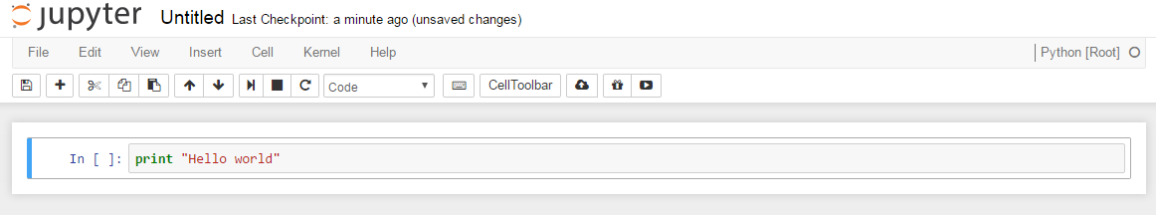
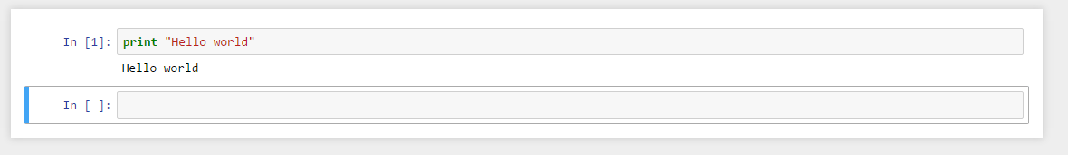
Using Jupyter Notebooks (do this now)
You will start off with a single empty code cell. Type the following into the cell: print "Hello world"
Hit Shift+Enter to run the cell. This will execute the code in the cell and then create a new empty cell below.
Notes:
Keep this notebook open for now! We'll use it again in a minute.

Slide 18
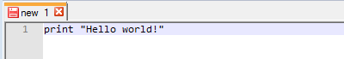
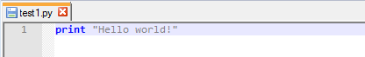
Using scripts
Step 1: Creating a script
Open a plain text editor (Notepad++, TextWrangler)
Type the following:
Save your file in your lab1 folder as test1.py
Note: Depending on your text editor, you may notice some of the code has changed colors. This is called syntax highlighting:
Notes:
Side notes:
Syntax highlighting makes reading code easier by color-coding different types parts of your code (e.g. functions = blue, strings = gray, numbers = red)
A good text editor has syntax highlighting specific to a variety of different programming languages
The editor determines what language you're using based on the file extension you save your file as – in this case, .py indicates Python.

Slide 19

Using scripts
Step 2: Running the script
Open your terminal and navigate to the folder where you saved your script (use cd, ls, and pwd).
Once in the correct folder, type: python test1.py
Python will now attempt to execute your script. If there are no errors in your code, you should see something like this:
Notes:
You always have to either be in the same directory as your script, or provide a path to the script when running it.
An example of providing a path would be something like this:
python ../../my_code/test1.py
This would of course change depending on which directory you're in relative to the script.

Slide 20
So which method should I use?
Notebooks are nice because you can see the output as you go along, rather than having to execute it as one monolithic script.
Scripts are easier to share (because they're plain text) & can be run from the command line
Bottom line:
For learning & exploratory analysis: Jupyter Notebooks
For anything else: scripts
Notes:
As an example of a situation where you would definitely want to use a script:
Imagine you have come up with a special new way to analyze RNA-seq data. You would like to publish or share your method so that others can use it. In this case, you will definitely want to distribute your code as a script. Here it is actually an advantage that a script executes as a single entity, because your users won't want to have to click through a notebook every time they use your script. They want something that's essentially automatic.
It would, however, be fine to initially develop the method in a notebook, and then transfer the code to a script later once you have the method perfected.

Slide 21
3. Print statements

Slide 22
Print statements
print "Hello world!"
This is called a print statement.
The print function prints text (or other content) to the screen.
In order to print a line of text (called a string in the programming world), we must enclose the text in quotes. Note that the quotes were not printed to the screen.
command aka "function"
text aka "string"
Notes:
Side notes:
The print function works somewhat differently than other functions we'll be seeing in the future
Most functions are in the format function(arg)
In fact, the print function can be written this way too—try print("Hello world"). (This is optional for print, but not for other functions)

Slide 23
Test out printing (do this now)
Try the following in a Jupyter notebook
(remember it's Shift+Enter to run a cell)
print "Hello" + "world"
print "Hello", "world"
print 123
print 1 + 2
print 2 * 3
print "1 + 2"
print "1 + 2 =", 1 + 2, "!"
Notes:
(Note to self: Do this on screen so everyone can see results)
Things to note:
Yes, you can do math this way, and it works pretty much the way you'd expect
Numbers do not require quotes around them. If you do add quotes, the numbers will be treated as strings rather than numbers.
A comma can be used to print multiple things at once. In particular, this is necessary for when you would like to print a mix of strings and numbers (e.g. the last example)
Note that using a comma in a print statement automatically adds a space in the printed output in place of the comma

Slide 24
Variations on the print statement
Code | Output | Reason
print "hello world" | hello world | The text in quotes is printed as typed (the quotes are not printed)
print "hello" + "world" | helloworld | "Adding" strings together concatenates them
print "hello" print "world" | hello world | A "newline" (return) is inserted after each print statement
print "hello", print "world" | hello world | Adding the comma at the end of the print statement suppresses the automatic newline
print "hello", "world" | hello world | adding a comma also allows you to print multiple things in one print statement. (this will be useful when we start using variables.) Notice that a space was automatically inserted between the words
print "hello" * 3 | hellohellohello | Print something multiple times.
print 5 | 5 | You can print numbers (no quotes)
print 1 + 2 | 3 | You can also print the results of math operations
Notes:
Don't worry about trying to remember all this right now, just know that these sorts of things are possible and refer back to this slide when you need it.
More on valid math operations later in this lecture.

Slide 25
4. Understanding error messages

Slide 26
Understanding error messages
Type the following in a new notebook cell and hit Shift+Enter:
print hello

Slide 27
Understanding error messages
Type the following in a new notebook cell and hit Shift+Enter:
print hello
Output:
-------------------------------------------------------------------
NameError Traceback (most recent call last)
<ipython-input-1-9553ee03b645> in <module>()
----> 1 print hello
NameError: name 'hello' is not defined

Slide 28
Understanding error messages
-------------------------------------------------------------------
NameError Traceback (most recent call last)
<ipython-input-1-9553ee03b645> in <module>()
----> 1 print hello
NameError: name 'hello' is not defined
This is a typical Python error message. It gives you several pieces of useful information to help you figure out what went wrong:
A line number - This is the line in your program where the error occurred. If you are using a script, the first thing you should do is find this line and examine it.
An explanation - This message should give you some idea of the nature of the error.
Sometimes these messages are hard to understand. If you can't figure out what's wrong, your best bet is to copy and paste the "explanation" part of the error message into Google. Look for forum posts of other people who got your same error.
Notes:
Side notes:
Don't expect to find someone with exactly the same problem as you when you do a search. Just skim the answers for general hints of the type of problems that give this error, and see if they apply to you.
Sometimes just searching the name of the error, in this case "NameError", will give better results. You can try searching "python NameError" to make sure your results are specific to python
Not all error messages will look exactly like this, but most should have some useful info you can use.

Slide 29
Understanding error messages
---------------------------------------------------------------------------
NameError Traceback (most recent call last)
<ipython-input-1-9553ee03b645> in <module>()
----> 1 print hello
NameError: name 'hello' is not defined
So what went wrong here?
We forgot to put quotes around hello. When Python sees a word with no quotes around it, it assumes that word is a variable.
Since we did not create a variable called hello yet, Python displays an error message.
If we had been running a script, Python would have terminated the execution of the entire script as soon as the error was encountered.

Slide 30
5. Variables and data types

Slide 31
Introduction to variables
What is a variable?
You can think of variables as little boxes that we put data in. You name each box so that you can refer to it and use it in your code. This gives your code flexibility (for reasons you will see soon).
Creating a variable is sometimes called declaring or defining a variable. This needs to be done before you can use the variable.
You can name your variables almost anything, but avoid using names that are also commands in Python (e.g. don't name a variable "print")

Slide 32
Introduction to variables
For example:
geneID = "Fmr1"

Slide 33
Introduction to variables
For example:
geneID = "Fmr1"
variable name
data
"assignment operator"

Slide 34
Introduction to variables
For example:
geneID = "Fmr1"
stored in
variable name
data
"assignment operator"
In english: Store the value "Fmr1" in "geneID"
Notes:
Side notes:
Although the equals sign is used here, don't think of this as an equation. A single equals sign in Python means that we are assigning the value on the right side to the variable on the right side.
The values of a variable can be overwritten by simply assigning something new to it. For example, if in this example geneID already had a value, we would have overwritten it here by saying geneID = "Fmr1"

Slide 35
Important: Choosing variable names
What words are ok to use for variable names?
Rules (if you break these, you'll get errors):
only letters, numbers, and underscores can be used in a variable name
the variable name can not begin with a number
you can not use any of the python reserved words as a variable name
the capitalization of your variables matters. For example, geneID and geneid would be considered different variables.
Conventions (recommended):
begin a variable name with a lower case letter
use a name that is descriptive of the info stored in the variable
if your variable name is more than one word squished together, use camelCase or under_scores to make it easier to read.
Notes:
Side notes:
if it's not clear, "camel case" means leaving the first word lower case and all following words upper case to make it easier to read. justLikeThis.
Is it ok to capitalize the first letter of you variable names? Yes, but it's almost never done, because in some language capitalized words are used for a different naming purpose (naming classes, to be specific).

Slide 36
Examples of variable names
Bad variable names:
3rdColumn (illegal)
sdasqweksf (gibberish)
person# (illegal)
class (reserved word)
Good variable names:
geneID
personCount
input_file
avgGeneCount

Slide 37
Python reserved words
The following words have special meaning to python and cannot be used as variable names:
If you get a weird error for a variable, check if it's on this list.
and | as | assert | break | class | continue
def | del | elif | else | except | exec
finally | for | from | global | if | import
in | is | lambda | nonlocal | not | or
pass | raise | return | try | while | with
yield | True | False | None
Notes:
If you have proper syntax highlighting in your text editor, it should be obvious when you accidentally use a reserved word because it will be a different color than all your other variables!

Slide 38
Question 1
What will this code print?
geneID = "Fmr1"
print geneID
Notes:
Now we'll go over a few examples to illustrate how variables and printing work.
For each of these problems, first try to guess what the output will be. A lot of these will touch on things I haven't specifically taught you yet, but you might find that you are able to guess the answer anyway.
This first question, for example -- I haven't told you yet what happens when you print a variable. What do you think will happen?
(Optional, for people in lecture: Input your answers to this online form so I can get a sense of how people are doing. This is purely for my own information; it's totally anonymous)

Slide 39
Question 1
What will this code print?
geneID = "Fmr1"
print geneID
Result
Fmr1

Slide 40
Question 2
What will this code print?
apples = 5
oranges = 10
fruit = apples + oranges
print fruit

Slide 41
Question 2
What will this code print?
apples = 5
oranges = 10
fruit = apples + oranges
print fruit
Result
15
Notes:
We can add two variables together if they both contain numbers.

Slide 42
Question 3
What will this code print?
apples = 5
oranges = 10
print apples + oranges

Slide 43
Question 3
What will this code print?
apples = 5
oranges = 10
print apples + oranges
Result
15
Notes:
Note that the addition is done before printing.

Slide 44
Question 4
What will this code print?
apples = 5
oranges = 10
print apples, oranges

Slide 45
Question 4
What will this code print?
apples = 5
oranges = 10
print apples, oranges
Result
5 10
Notes:
So the comma is not the same as the +. The comma is basically for separating multiple types of things we would like to print.

Slide 46
Question 5
What will this code print?
apples = 5
oranges = 10
print "I have", apples, "apples"

Slide 47
Question 5
What will this code print?
apples = 5
oranges = 10
print "I have", apples, "apples"
Result
I have 5 apples
Notes:
This allows us to insert the value of a variable into our print statement.

Slide 48
Question 6
What will this code print?
people = 3
people = people + 1
print people

Slide 49
Question 6
What will this code print?
people = 3
people = people + 1
print people
Result
4
Notes:
This is an important one to understand. What we did here was overwrite the value of people with the value of people + 1. Since the right side of the = sign is evaluated first, the value of the right side is 3 + 1, or 4. This is then assigned to the variable on the left, which in this case overwrites the value of people with the number 4.
Later on, this is how we will create counters, i.e. variables that we increment by 1 whenever we do a certain task.

Slide 50
Question 7
What will this code print?
people = 3
animals = 4
people = animals
print people
print animals

Slide 51
Question 7
What will this code print?
people = 3
animals = 4
people = animals
print people
print animals
Result
4
4
Notes:
Another example of overwriting a variable. Note that the value of animals is unchanged.

Slide 52
Question 8
What will this code print?
name = "Joe Shmo"
age = 20
print name,"will be",(age + 1),"next year"

Slide 53
Question 8
What will this code print?
name = "Joe Shmo"
age = 20
print name,"will be",(age + 1),"next year"
Result
Joe Shmo will be 21 next year
Notes:
Here we did some math within the print statement.
If we now printed the value of age, what would you expect it to be?
=> Answer: it would still be 20! We did not overwrite the value of age. We simply added 1 to its value when we printed. To overwrite a variable, we must use the assignment operator (equals sign) with the variable on the left hand side.

Slide 54
Question 9
What will this code print?
yourAge = "16"
print "You will be", (yourAge + 1), "next year"

Slide 55
Question 9
What will this code print?
yourAge = "16"
print "You will be", (yourAge + 1), "next year"
Result
You will be
---------------------------------------------------------------------
TypeError Traceback (most recent call last)
<ipython-input-3-8072ce5634fd> in <module>()
1 yourAge = "16"
----> 2 print "You will be", (yourAge + 1), "next year"
TypeError: cannot concatenate 'str' and 'int' objects

Slide 56
Question 9
What will this code print?
yourAge = "16"
print "You will be", (yourAge + 1), "next year"
Result
You will be
---------------------------------------------------------------------
TypeError Traceback (most recent call last)
<ipython-input-3-8072ce5634fd> in <module>()
1 yourAge = "16"
----> 2 print "You will be", (yourAge + 1), "next year"
TypeError: cannot concatenate 'str' and 'int' objects
What happened?
We put the number 16 in quotes--this makes it a string instead of an integer!
Python can't do addition with strings, so it gives an error message.
Notice that it starts to print the message, but fails when we try to do the addition.
Notes:
Note, Python can actually do addition of two string, e.g. "16" + "1". However, the result of this will be string addition (aka concatenation), not numerical addition. The result will therefore be "161" instead of 17.

Slide 57
Variable data types
Data comes in different types – numbers, words, letters, etc.
In Python, certain types of data are treated differently. There are four main "data types" we'll be working with:
String - a string is just another word for text. You can think of it as "a string of letters/characters". Strings are enclosed in double or single quotes to distinguish them from variables and commands (ex: "This is a string!" 'So is this!')
Integer ("int") - this refers to whole numbers (same as in real life). In programming, integers are handled differently than non-integers, which is why we make this distinction.
Floating point numbers ("float") - numbers with decimals.
Booleans –True or False (1 or 0). We'll talk more about this later.

Slide 58
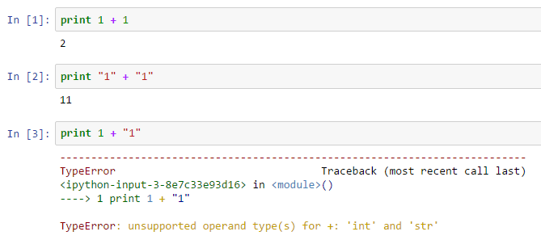
Converting between data types
As we've seen, different types of data are treated differently by Python:
No quotes; treated as integers → sum
Quotes; treated as strings → concatenate
Mixed; not compatible! → error

Slide 59
Converting between data types
Sometimes we'll want to convert one data type into another.
Python provides simple built-in functions for a few types of conversions.
Here's a partial list:
Function | Conversion type | Works on...
str() | Converts variable into a string | Integers, floats, booleans (and others)
int() | Converts variable into an integer | Numbers in string form Floats (decimal will be truncated) Booleans (True → 1, False → 0)
float() | Converts variable into a float (decimal) | Numbers in string form Integers ( .0 will be added) Booleans (True → 1.0, False → 0.0)

Slide 60
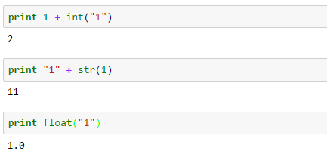
Examples of conversion
Now this works!

Slide 61
6. Basic math operations

Slide 62
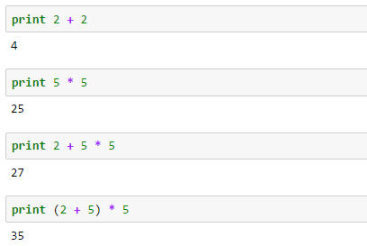
Doing math in Python
Math in Python uses most of the symbols and conventions you're already used to:
Order of operations (P.E.M.D.A.S.) is maintained

Slide 63
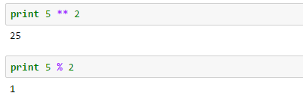
Doing math in Python
There are a few differences, however:
Use ** for exponents
Use % to get remainders
(aka "modulus" or "mod")

Slide 64
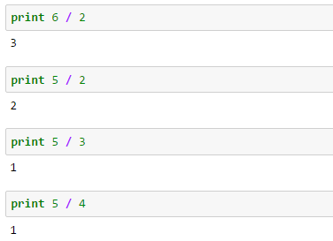
Doing math in Python
The most important thing to watch out for is integer division:
Why are all of these answers rounded down?
Notes:
6 / 2 works, but why are the rest rounded down?

Slide 65
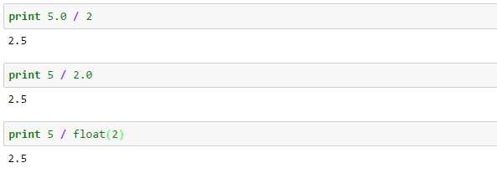
Integer division
Whenever you divide two integers, python always returns an integer answer
Since integers are always whole numbers, python just truncates off the decimal
To get a proper answer, at least one of the numbers being divided must be a float:
This is a very common source of errors, so keep it in mind when you divide!
When in doubt, convert one number with float().

Slide 66
List of math operators
Operation | Result
x + y | sum of x and y
x - y | difference of x and y
x * y | product of x and y
x / y | quotient of x and y
x // y | (floored) quotient of x and y
x % y | remainder of x / y
x ** y | x to the power y

